Slide 1
JavaScript objects
An introduction to objects in JavaScript

Slide 2

Real life Objects
A car is an object
It has properties: For example, make and model
It has methods: For example, start and stop
All cars have the same properties, but their values may be different
All cars have the same methods, but may be performed at different times

Slide 3
JavaScript objects
JavaScript objects are variables containing variables
var myObject = {}; This creates an empty object. No properties or methods.
JavaScript objects use the key and value system
var car = {make: ‘Honda’, model: ‘CR-V’, color: ‘Silver’
information: function() {
console.log(this.make, this.model, this.color);
}};

Slide 4
Object Properties
var person = {firstName: ‘Joe’, lastName: ‘Flannigan’};
To access a property:
person.firstName;
person.lastName;

Slide 5
Object Methods
Methods are stored in properties as function definitions
var person = { firstName: ’Cal’, lastName : ’Wilson’, fullName : function() { return this.firstName + " " + this.lastName; }};
person.fullName; This returns: function() {return this.firstName + " " + this.lastName;}
person.fullName(); This returns: Cal Wilson

Slide 6
The This keyword
Refers to the “owner” of the object.
var person = { firstName: ’Cal’, lastName : ’Wilson’, fullName : function() { return this.firstName + " " + this.lastName; }};
person is the owner.

Slide 7
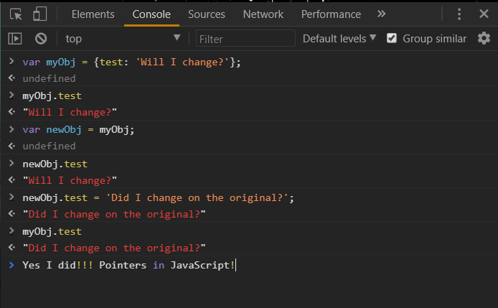
Things to Be careful about
Settings new objects equal to other objects

Slide 8
Things to avoid doing
Do not declare primitive data types (string, number, Boolean) as objects!
var s = new String();
Var n = new Number();
Var b = new Boolean();
This will change the data type from primitive to an object! This makes your code much less efficient and slower.

